Slide 1
Homework 4

Slide 2
Homework 4
Introduce a big data / IoT / AI / AR / VR / application
Intelligent Manufacturing
Intelligent Transportation
Smart Grid
Smart City
Precision Marketing
Precision Medical
AI
Metaverse
…

Slide 3
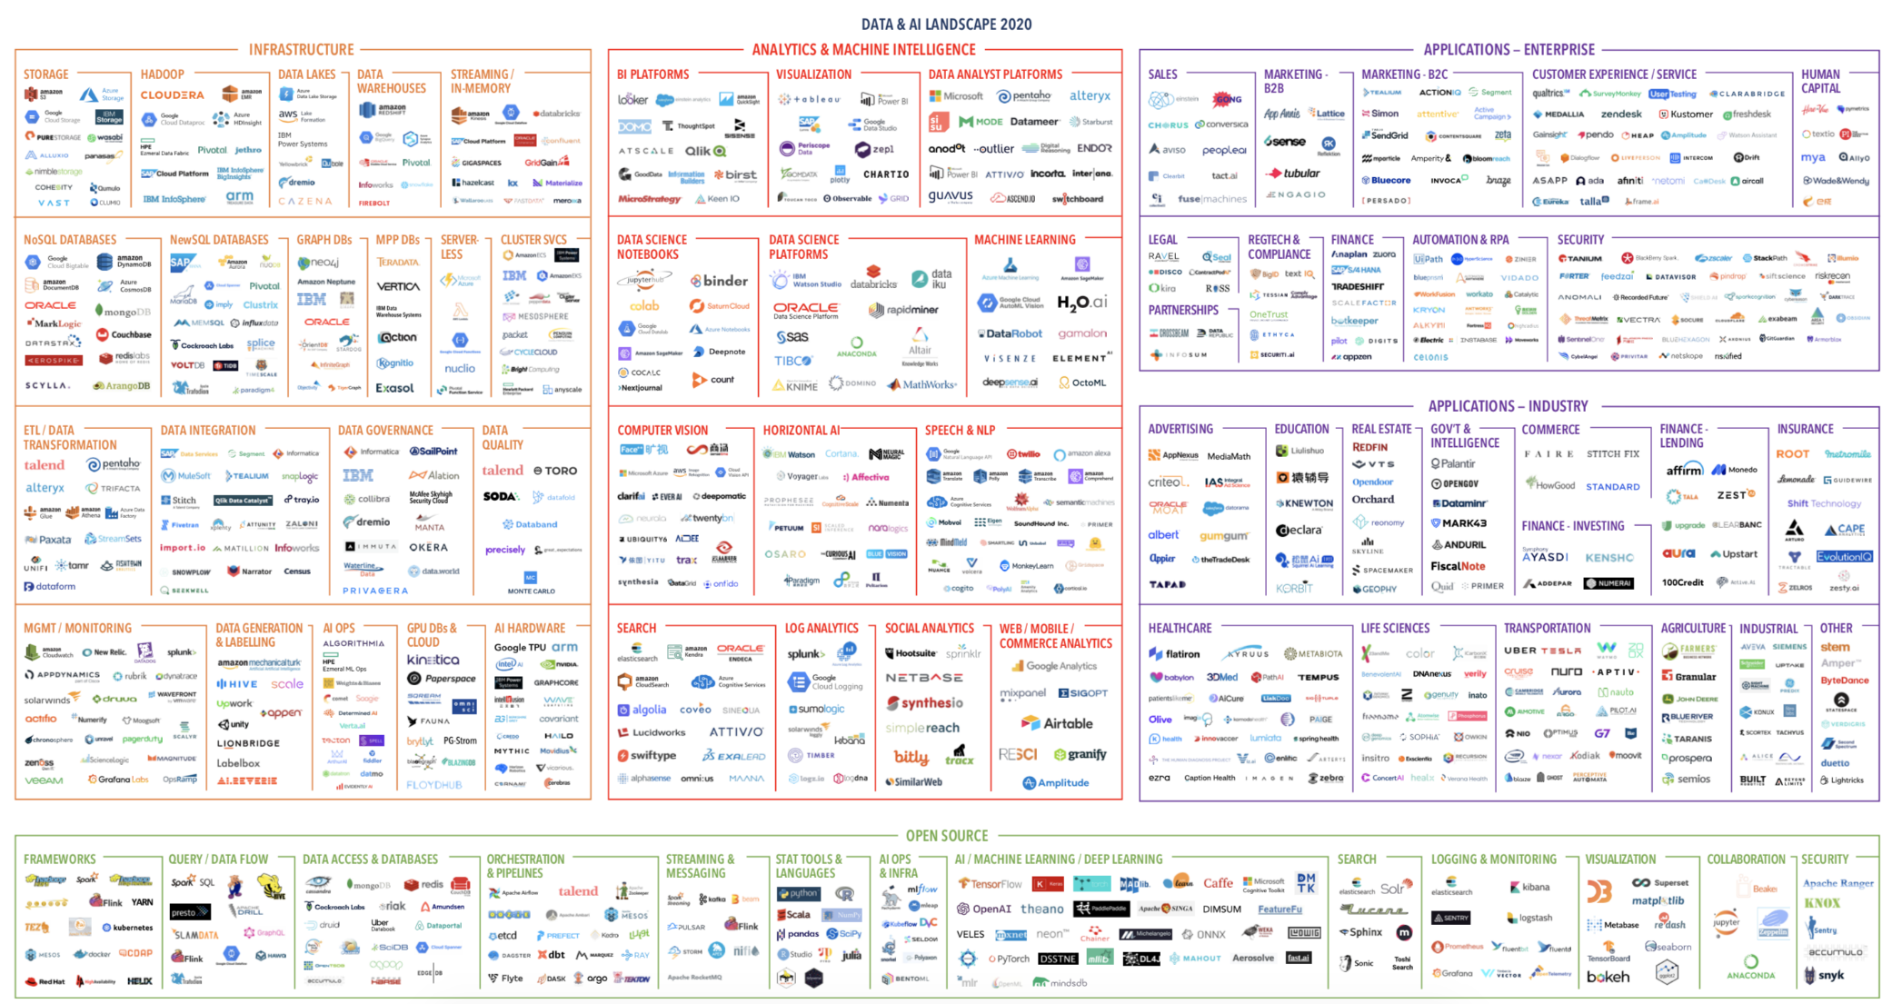
Homework 4

Slide 4
Homework 4
Introduce a big data / IoT / AI / AR / VR / application
Introduce the application
Introduce the data
How to collect
How to analysis
…
Others
The difficulty of this application
…

Slide 5
Homework 4
Written report
As least 3 pages (A4 size)
Soft copy only
Deadline
2022/06/02 23:59
Submit
Portal
Filename (SID_hw4.docx or SID_hw4.pdf)

